Slide 1
Hands-On Network Security and System Administration Lab
Proposed Course Overview and Introduction
The course outlines
Demo Video
Building skills to manage and protect real-world IT infrastructure
Instructor: Alan S. H. Lam
Notes:
Welcome! This lab course provides hands-on experience managing and securing IT systems.

Slide 2
Course Overview
Two Major Parts:
1. System and Network Administration
2. System and Network Security Defense
Goal: Understand, monitor, and defend IT Infrastructure.
Notes:
We'll first learn how networks behave normally, then move on to defending them.

Slide 3
Why Start with System and Network Administration?
You can’t defend what you don’t understand.
Learn your network’s normal baseline.
Detect abnormal behavior early.
Build confidence managing real systems.
Notes:
Before recognizing a cyberattack, you must know what 'normal' looks like.

Slide 4
Part 1: System and Network Administration
Set up and manage servers and services
Monitor network traffic and performance
Debug and optimize IT infrastructure issues
Interpret real-time data and logs
Notes:
We’ll use both command-line and GUI tools to monitor and troubleshoot networks.

Slide 5
Professional Tools You’ll Use
Monitoring & Management: snmpd, mrtg, ntopng, nagios, TIG Stack
Testing & Debugging: hping3, traceroute, iperf3
Traffic and system Analysis: tcpdump, wireshark, netstat, lsof, ss
Demo Video
Notes:
These are industry-standard tools used by professionals daily.

Slide 6
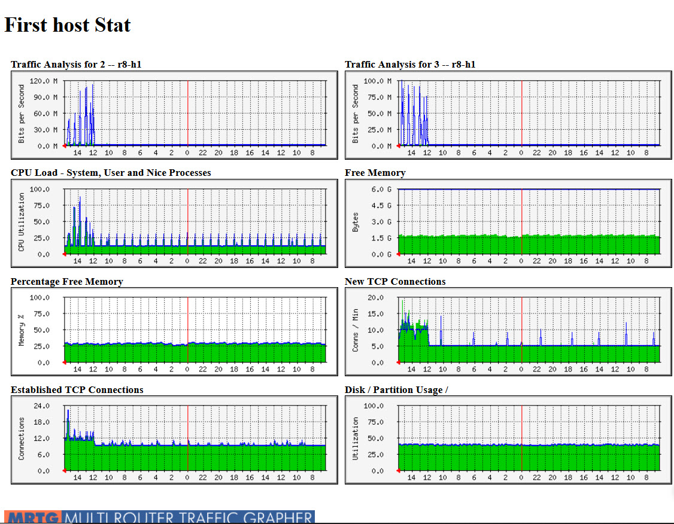
MRTG graphs monitoring network traffic and system status
Notes:
MRTG continuously collects and visualizes network and system performance data every five minutes. Although it samples periodically, it provides powerful long-term insights — displaying traffic trends across daily, weekly, monthly, and yearly views. This helps you establish baselines and quickly spot unusual patterns that might signal network issues or potential attacks.

Slide 7
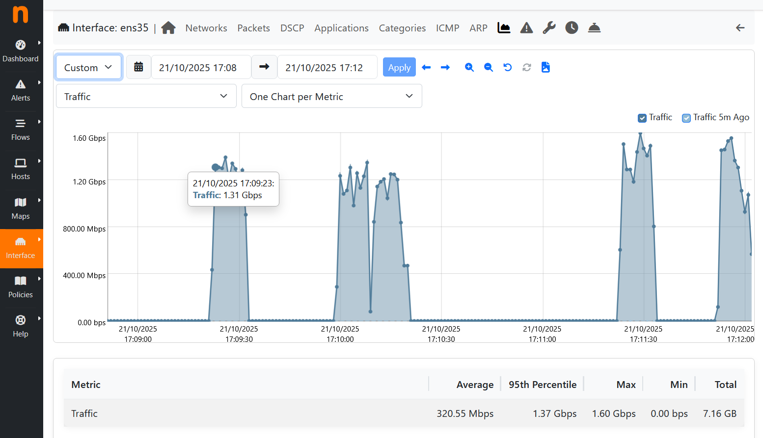
ntop-ng Showing Server Network Interface Traffic in iperf3 Bandwidth Testing
Notes:
For real-time traffic visualization, ntop-ng is ideal. This graph displays instant bandwidth data during an iperf3 test — showing traffic fluctuations over the last few minutes. It’s useful for observing live performance, detecting bottlenecks, and confirming that your network is performing as expected.

Slide 8
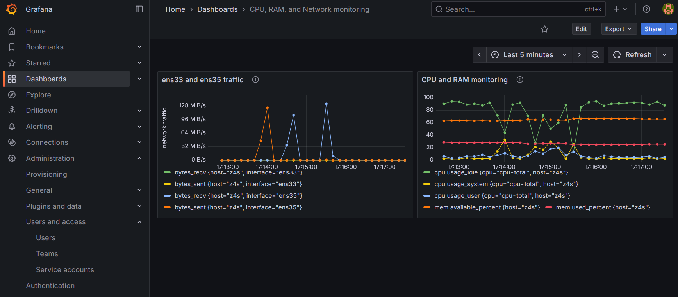
TIG Stack Monitoring Network Traffic and System Health
Notes:
The TIG stack — Telegraf, InfluxDB, and Grafana — allows you to build custom dashboards for monitoring your infrastructure. You can design visual panels to track system health, network throughput, or specific service performance. This flexibility helps you tailor the monitoring view to your own operational or research needs.

Slide 9
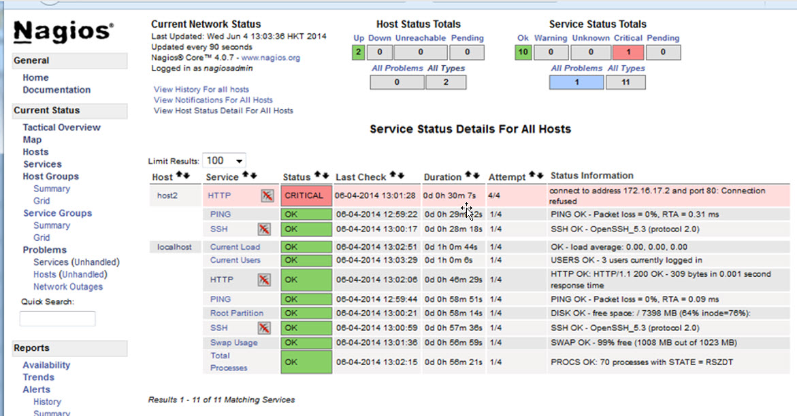
Nagios Monitoring Critical IT Services and Sending Alerts
Notes:
Nagios helps you keep your IT infrastructure reliable by monitoring critical services like web servers, mail servers, or DNS. When it detects an issue or outage, Nagios can automatically send alert notifications to administrators. This proactive monitoring ensures rapid response and minimizes downtime.

Slide 10
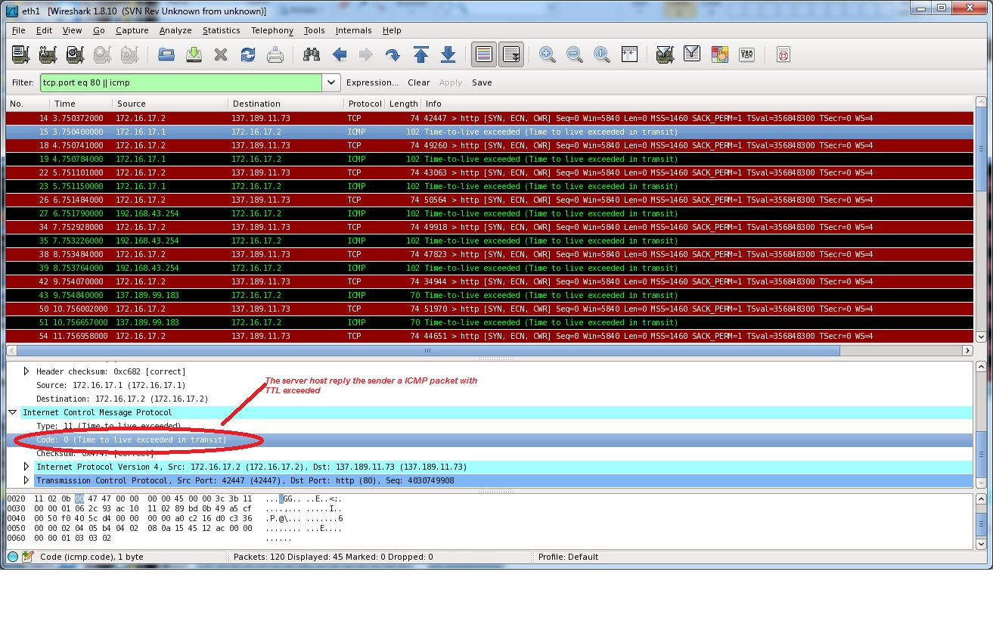
Network Traffic Analysis of Traceroute Packets by Wireshark
Notes:
Wireshark captures and analyses packets at a granular level. Here, it shows a router responding to traceroute packets with an ICMP “TTL exceeded” message — a normal step in mapping network hops. Tools like Wireshark and tcpdump let you observe how packets travel across the network, helping you understand both normal and abnormal behaviours.
You will exam more malware and cyber-attack traffic during real case studies.

Slide 11
Transition to Security Defense
Knowing your network baseline helps you:
- Spot intrusions faster
- Understand attack patterns
- Apply defense strategies effectively
Notes:
Once you master network monitoring, you’ll move on to security defenses.

Slide 12
Part 2: Securing Your IT Infrastructure
Firewalls & Two-Factor Authentication (2FA)
Suricata IDS/IPS for intrusion detection and prevention
Vulnerability scanning and penetration testing
Incident response and forensic investigation
Honeypots for hacker monitoring
Notes:
We’ll simulate and analyze real-world attacks and defenses.

Slide 13
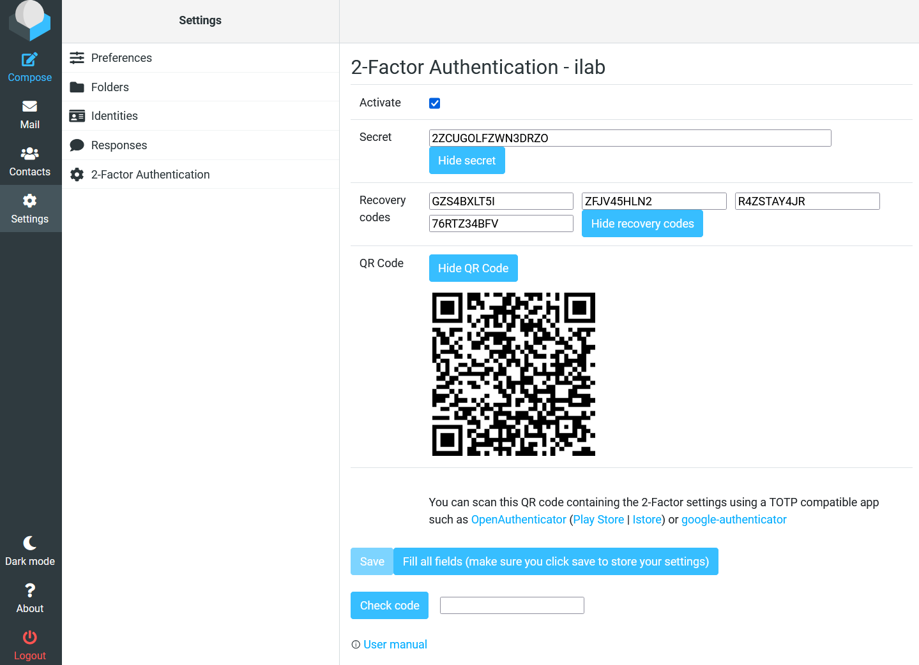
Example of 2FA Setup for Webmail User “ilab”
Notes:
This slide demonstrates how to enable two-factor authentication (2FA) for webmail users. By requiring both a password and a one-time code, 2FA greatly enhances account security and helps prevent unauthorized access even if passwords are compromised.

Slide 14
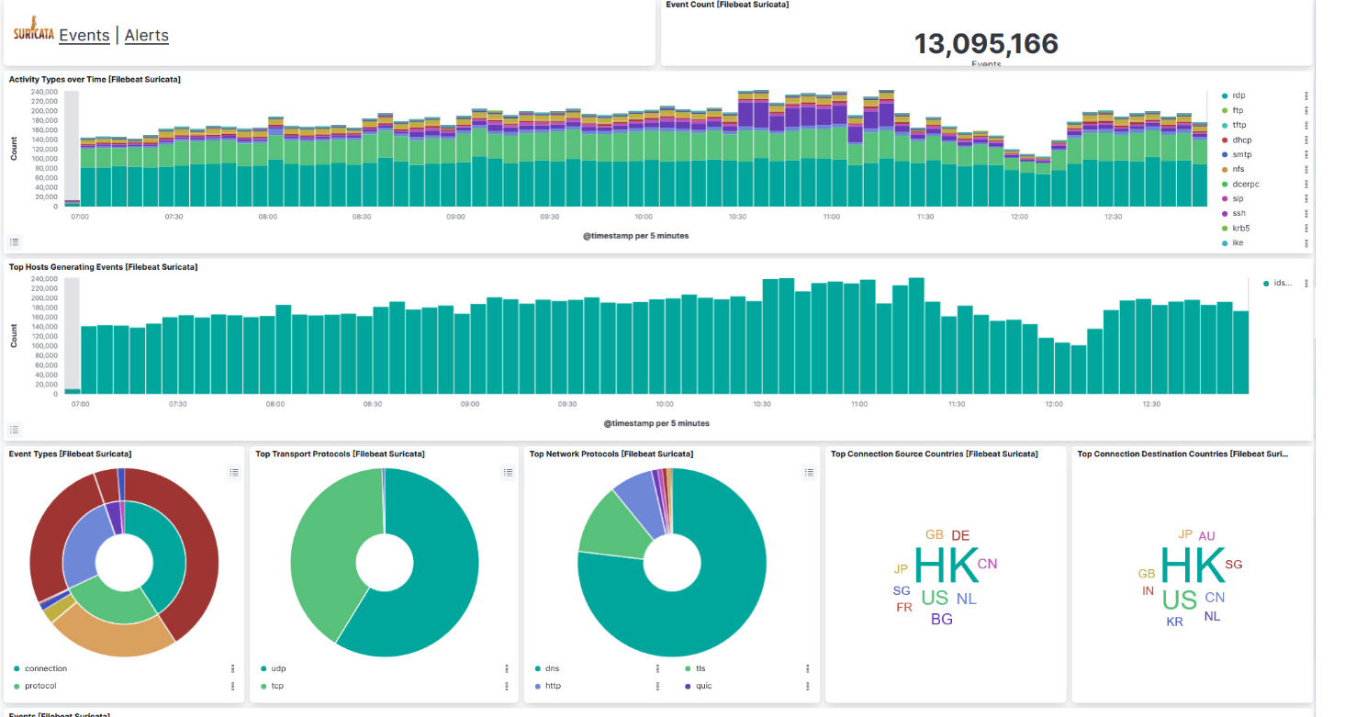
Suricata IDS Event Log Monitoring Network Uplink Traffic
Notes:
Suricata IDS continuously analyses your network uplink traffic and logs potential security events. The Suricata IDS can let you get familiar with your network profile

Slide 15
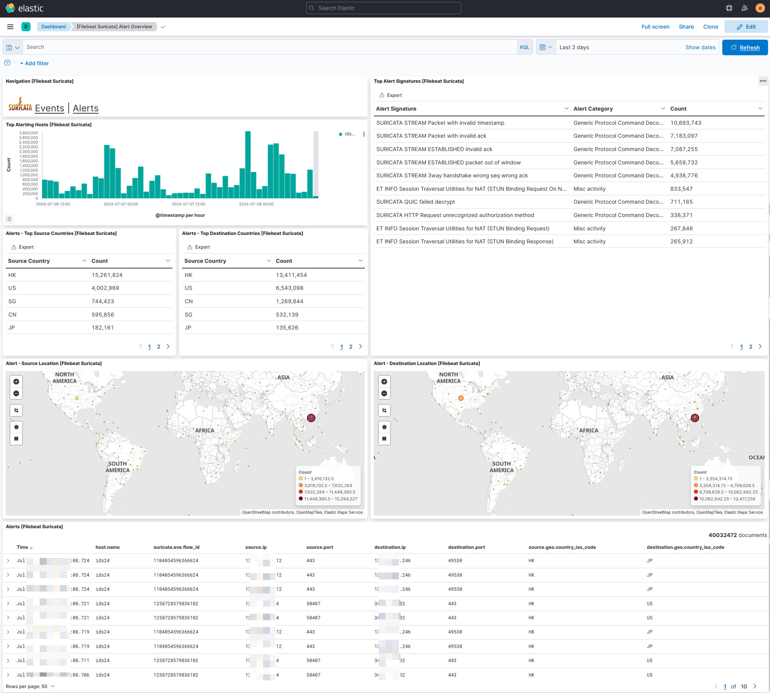
Suricata IDS Monitoring Potential Threats in Network Uplink Traffic
Notes:
By monitoring these alerts, you can build an understanding of your network’s normal traffic patterns and detect anomalies that might indicate suspicious or malicious activity.

Slide 16
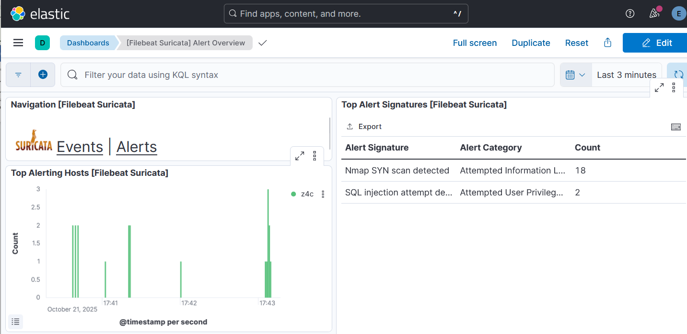
Suricata IPS Blocking Nmap Scan and SQL Injection in Real Time
Demo Video . You can download this lab Suricata IPS rules here.
Notes:
Suricata IPS takes security a step further by actively blocking malicious traffic. It can stop reconnaissance attempts like Nmap scans or exploitation efforts such as SQL injection. To use IPS effectively, you’ll need a solid understanding of network behaviour and malware traffic patterns so you can define accurate blocking rules.
I will teach you how to write the IPS rules to block cyber-attacks.

Slide 17
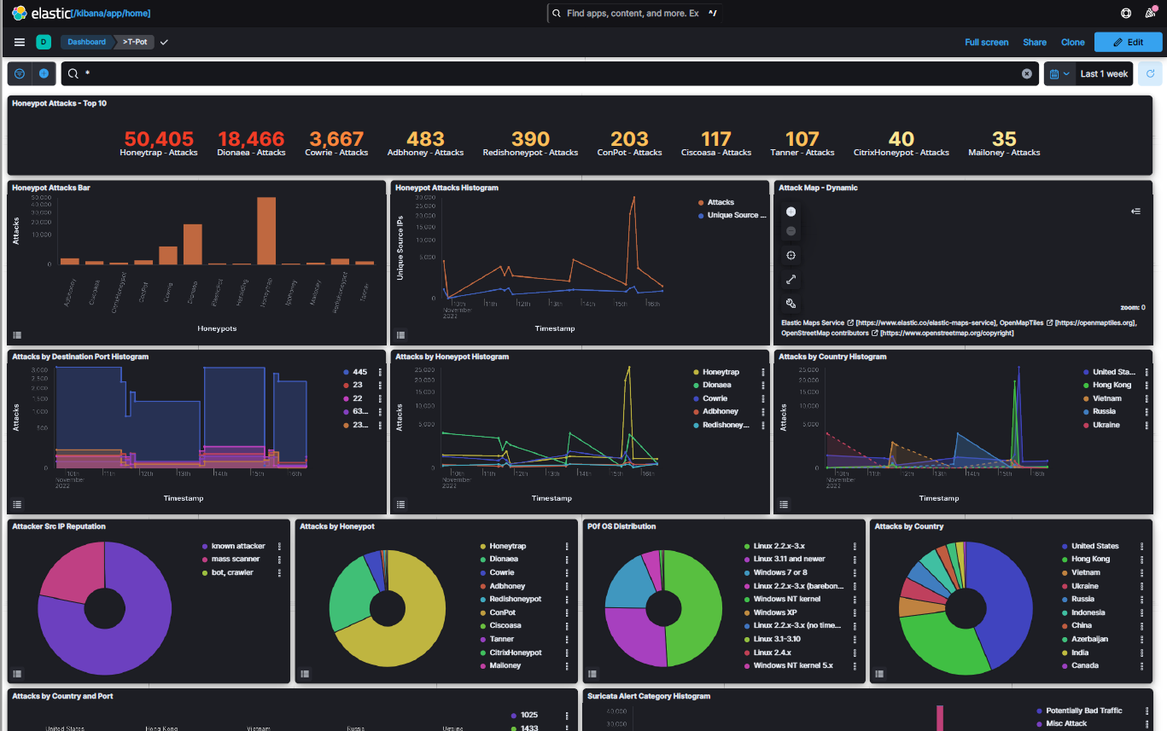
T-Pot Honeypot on AWS Cloud Showing Top Attack Events and Sources
Notes:
T-Pot integrates multiple honeypot systems to attract and log cyberattacks in real time. Deployed on AWS, it visualizes global attack trends, top targeted ports, and attacker origins. This gives valuable insight into current hacking tactics, techniques, and trends in the wild.

Slide 18
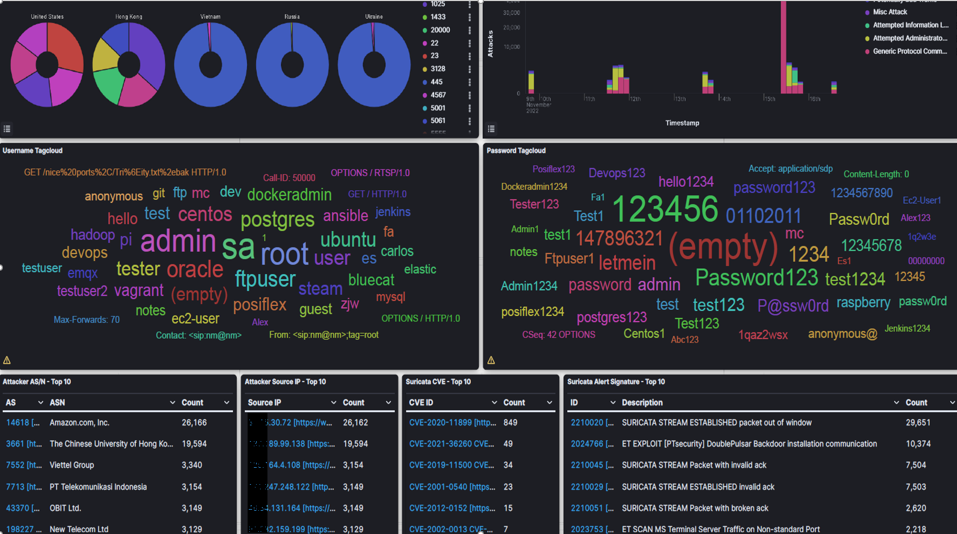
T-POT Honeypot on AWS Cloud — Password Brute-Force Attack Trend
Demo video. You can view the full report of my recent Honeypot study here.
Notes:
This T-Pot dashboard aggregates brute-force login attempts captured by multiple honeypots and visualizes the most commonly tried username/password combinations over time. You’ll typically see a small set of popular usernames (for example admin, root, sa) and weak passwords or leaked-password patterns (e.g., 123456, (empty), password123) repeated across many source IPs — a clear sign of automated credential-stuffing and botnet activity.

Slide 19
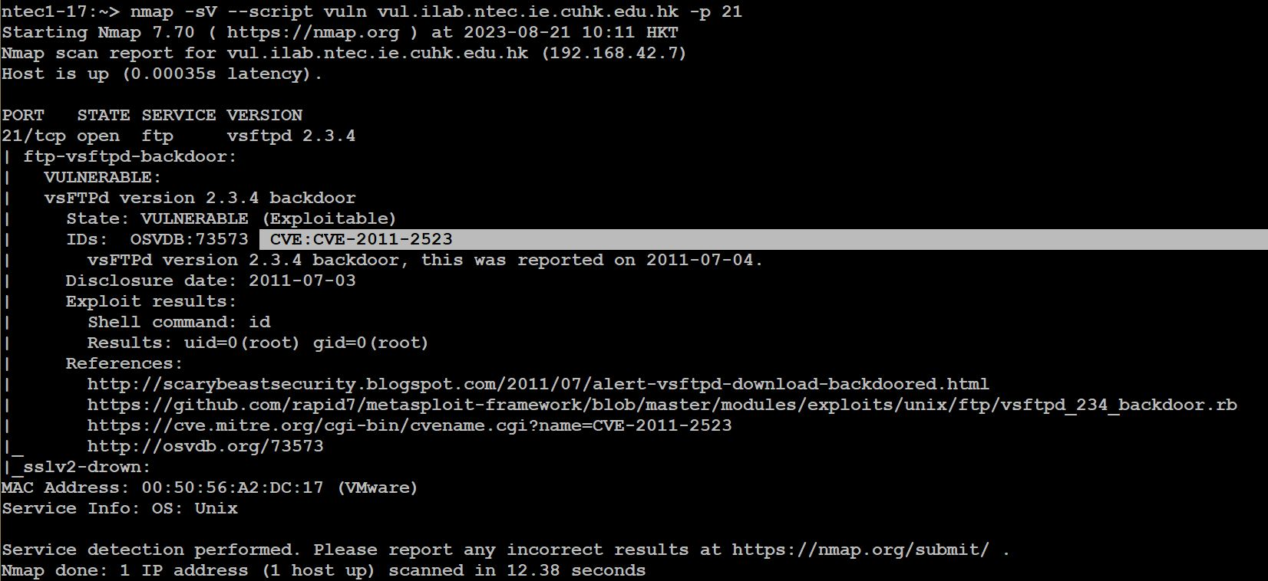
Vulnerability Scanner with Nmap — CVEs and Software Versions Detected
Demo Video
Notes:
Nmap isn’t just for scanning hosts — it can also identify software versions and match them to known CVEs. This makes it a lightweight but effective vulnerability scanner, allowing you to discover outdated or insecure software that could be exploited.

Slide 20
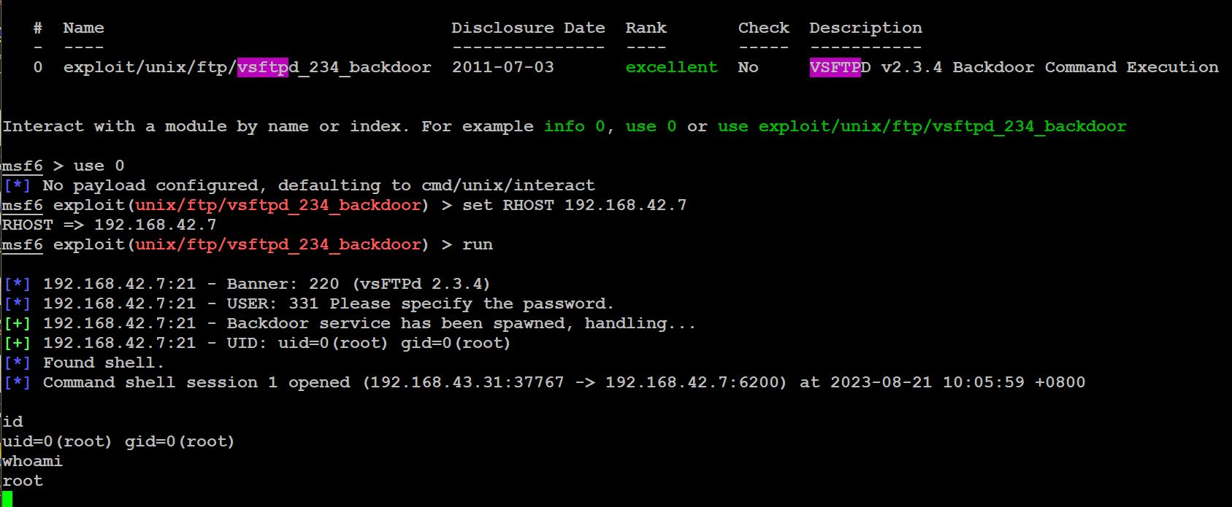
Penetration Test with Msfconsole Exploiting vsFTP Vulnerability and Gaining Root Access
Notes:
Msfconsole, part of the Metasploit Framework, is used to verify vulnerabilities found during scanning. Here, it demonstrates exploiting a known vsFTP vulnerability to gain root access — showing how attackers might compromise an unpatched system. This hands-on exercise helps you understand the attack lifecycle and design better defences.

Slide 21
Real-World Case Studies
Analyze real cyberattack scenarios
Learn from defensive failures
Study response strategies and forensic insights
You download more malware and cyber-attack network traffic samples and their analysis here.
Demo Video
Notes:
You’ll see how security incidents happen and how professionals respond.

Slide 22
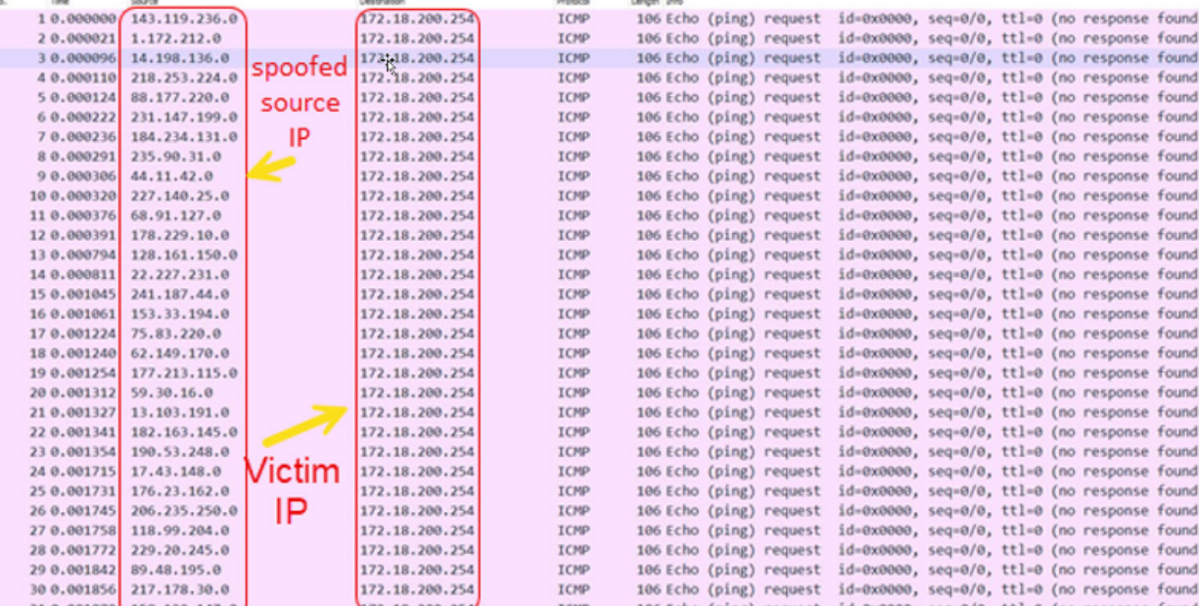
Smurf Attack — Distributed Denial of Service (DDoS) with ICMP
Notes:
A Smurf attack floods a victim server with ICMP echo requests using spoofed IP addresses, overwhelming its resources. This demonstrates how attackers exploit amplification techniques to disrupt network availability — a reminder of the importance of proper ICMP and broadcast filtering.

Slide 23
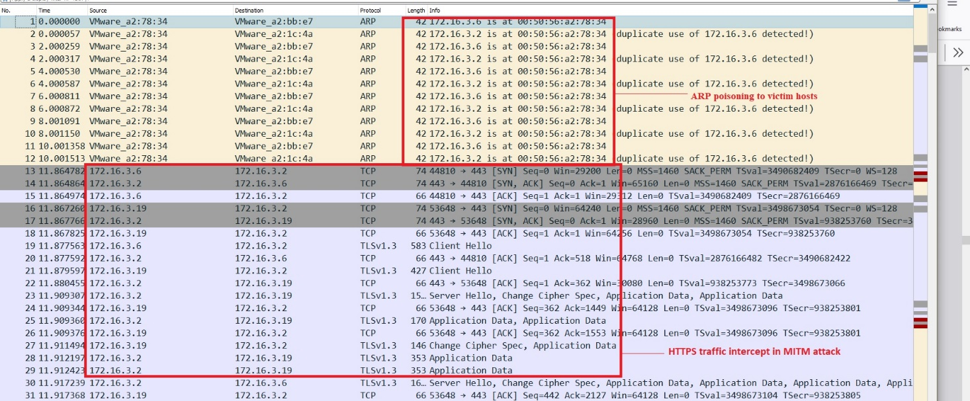
Network Packet Analysis of ARP Poisoning (MITM Attack with HTTPS Intercept)
Demo Video
Notes:
In this example, the attacker performs ARP poisoning, impersonating the default gateway to intercept network traffic. Even HTTPS sessions can be tampered with under such attacks. Wireshark analysis reveals duplicated or altered ARP responses — a clear sign of a man-in-the-middle attempt.

Slide 24
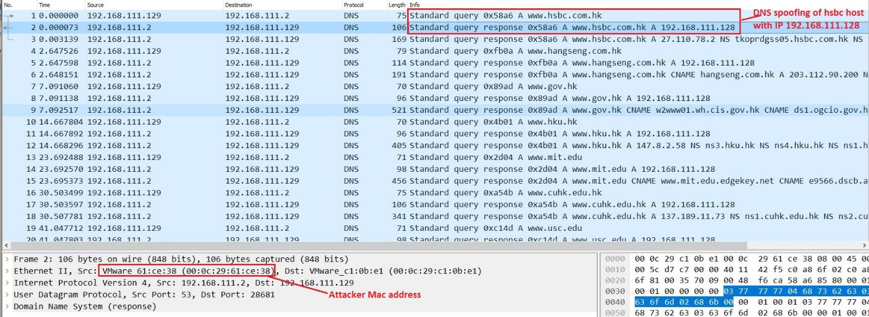
Network Packet Analysis of DNS Spoofing in Wireshark
Notes:
This analysis shows how an attacker redirected a victim’s web request by spoofing DNS responses. The victim’s browser unknowingly connected to a fake or phishing site. By examining packet details, you can see the forged DNS reply and learn to recognize these malicious manipulations.

Slide 25
AI for Cybersecurity
AI tools for:
- Vulnerability assessment
- Threat detection
- Forensic investigation
- Automated incident reporting
Demo Video.
You can view the network forensic analysis by AI here.
Notes:
We’ll explore how AI enhances cybersecurity operations.

Slide 26
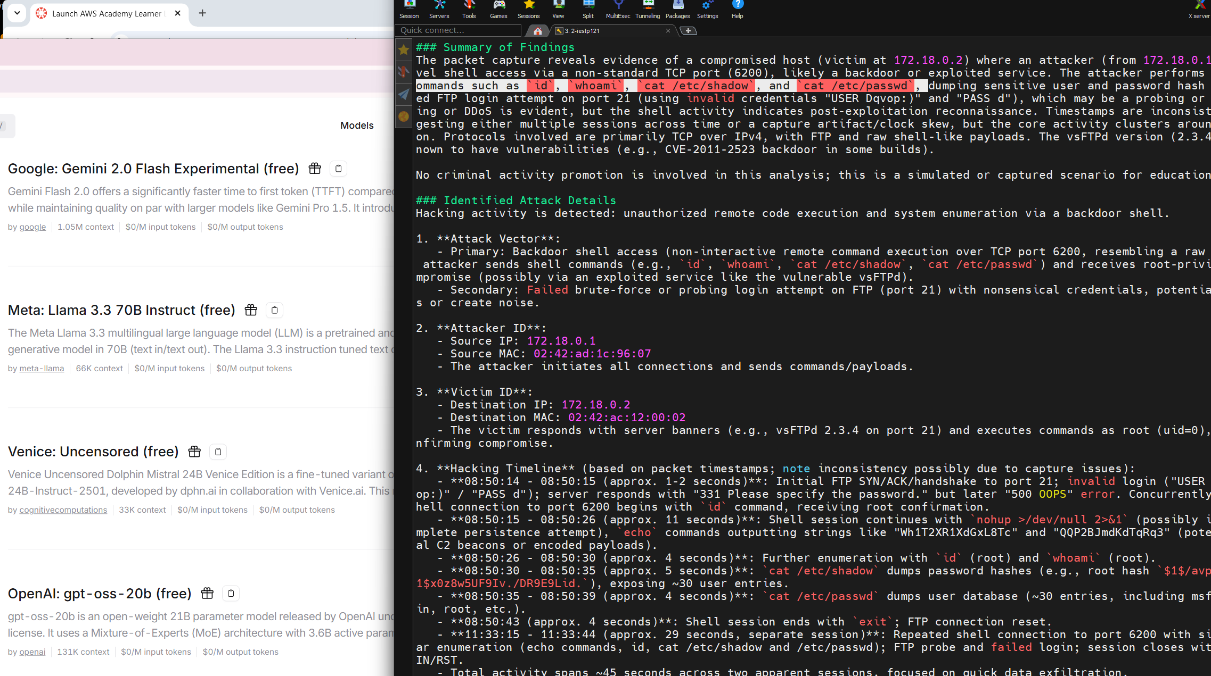
Malware traffic analysis with AI tool (xAI: Grok 4 fast model)
Notes:
This demonstration shows how an AI-based model — integrated via the OpenRouter API — can assist in analysing malware-related network traffic. The AI identifies unusual patterns, classifies potential threats, and accelerates forensic analysis. It’s an example of how machine learning can augment cybersecurity operations for faster, smarter detection.

Slide 27
What You’ll Gain
Real-world technical experience
Confidence in system & network management
Skills to detect and defend against cyber-attacks
Understanding of AI-powered cybersecurity tools
Notes:
By course end, you’ll be able to set up, monitor, and defend full IT infrastructure.

Slide 28
Final Message
“Security is not a product, but a process.” – Bruce Schneier
Let’s begin that process — hands-on!
Notes:
Thank you, and welcome to the lab!

